Slide 1
Network+ Guide to Networks Eighth Edition
Chapter 1
Introduction to Networking
© 2019 Cengage. All Rights Reserved. May not be copied, scanned, or duplicated, in whole or in part, except for use as permitted in a license distributed with a certain product or service or otherwise on a password-protected website for classroom use.

Slide 2
Objectives (1 of 2)
1.1 Distinguish between the client-server and peer-to-peer models used to control access to a network
1.2 Identify types of applications and protocols used on a network
1.3 Describe various networking hardware devices and the most common physical topologies

Slide 3
Objectives (2 of 2)
1.4 Describe the seven layers of the O S I model
1.5 Explain best practices for safety when working with networks and computers
1.6 Describe the seven-step troubleshooting model for solving a networking problem

Slide 4
Network Models
Topology—How parts of a whole work together
Physical topology—Mostly applies to hardware and describes how computers, other devices, and cables fir together to form the physical network
Logical topology—Has to do with software and describes how access to the network is controlled
How users and programs initially gain access to the network
Network operating system (N O S)—Controls access to the entire network
Required by client-server models

Slide 5
Peer-to-Peer Network Model (1 of 3)
Peer-to-peer (P 2 P) network model—The O S of each computer on the network is responsible for controlling access to its resources
No centralized control
Computers, called nodes or hosts, form a logical group of computers and users
May share resources
May prevent access to resources
Each computer user has a Windows local account
Works only on that one computer

Slide 6
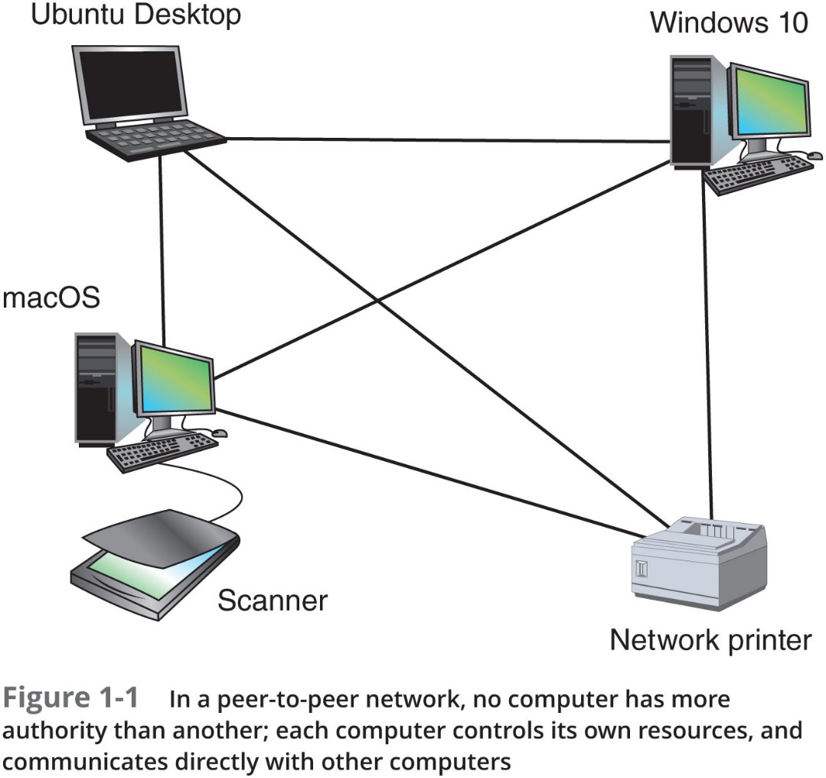
Peer-to-Peer Network Model (2 of 3)

Slide 7
Peer-to-Peer Network Model (3 of 3)
Advantages
Simple configuration
Less expensive
Compared to other network models
Disadvantages
Not scalable
Not necessarily secure
Not practical for large installations

Slide 8
Client-Server Network Model (1 of 5)
Resources are managed by the network operating system (N O S) via a centralized directory database
Windows domain—A logical group of computers that a Windows Server can control
Active Directory (A D)—The centralized directory database that contains user account information and security for the entire group of computers
A user can sign on to the network from any computer on the network and gain access to the resources that A D allows
This process is managed by Active Directory Domain Services (A D D S)

Slide 9
Client-Server Network Model (2 of 5)
Client
A computer making a request from another
Clients don’t share their resources directly with each other
Access is controlled by entries in the centralized domain database
Client computers access resources on another computer by way of the servers controlling the domain database

Slide 10
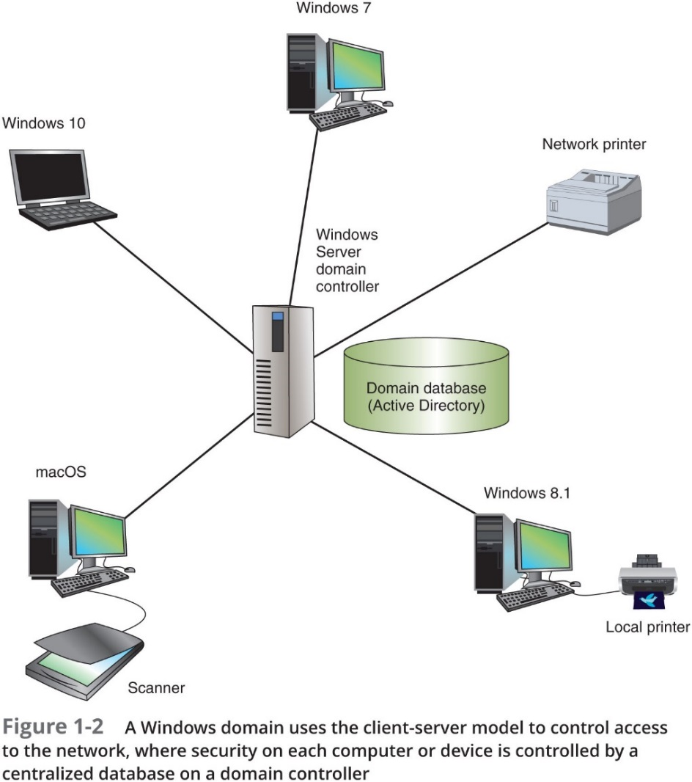
Client-Server Network Model (3 of 5)

Slide 11
Client-Server Network Model (4 of 5)
The N O S is responsible for the following activities:
Manages client data, resources
Ensures authorized user access
Controls user file access
Restricts user network access
Dictates computer communication rules
Supplies application to clients
Server examples
Windows Server 2016, Ubuntu Server, or Red Hat Enterprise Linux

Slide 12
Client-Server Network Model (5 of 5)
Servers that have a N O S installed require:
More memory, processing, and storage capacity
Equipped with special hardware
Provides network management functions
Advantages relative to peer-to-peer networks
User credential assigned from one place
Multiple shared resource access centrally controlled
Central problem monitoring, diagnostics, and correction capabilities
More scalable

Slide 13
Client-Server Applications (1 of 5)
Network services—The resources a network makes available to its users
Includes applications and the data provided by these applications
In client-server applications
A client computer requests data or a service from a second computer, called the server
Protocols
Methods and rules for communication between networked devices
Two primary protocols:
T C P (Transmission Control Protocol)
I P (Internet Protocol)
T C P/I P suite of protocols is used by O Ss for communication on a network

Slide 14
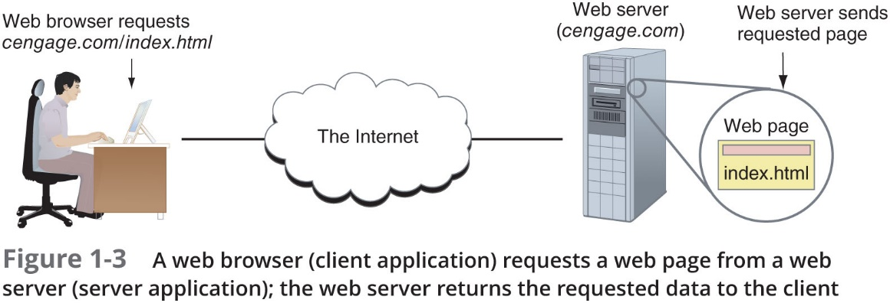
Client-Server Applications (2 of 5)

Slide 15
Client-Server Applications (3 of 5)
List of several popular client-server applications:
Web service
Email services
F T P service
Telnet service
Remote applications
Remote Desktop

Slide 16
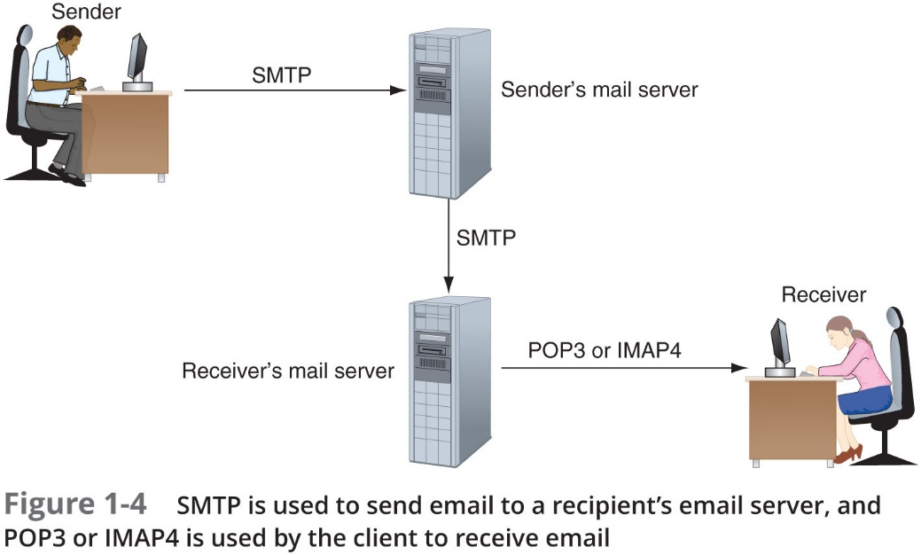
Client-Server Applications (4 of 5)

Slide 17
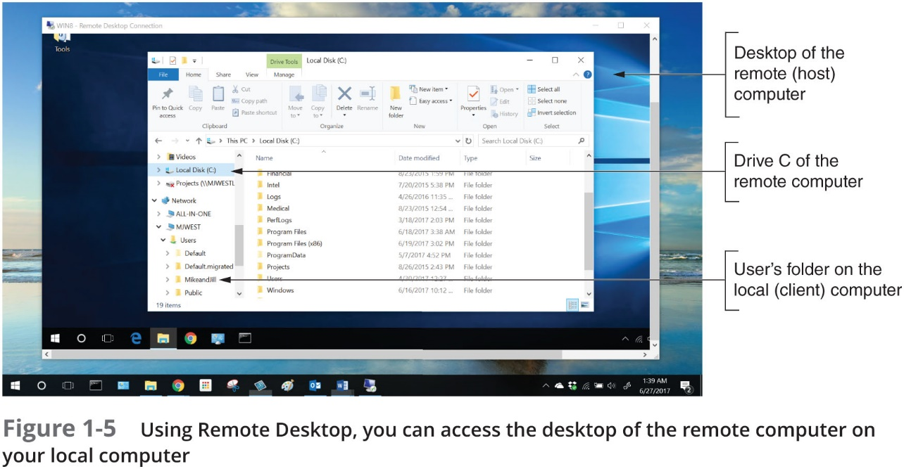
Client-Server Applications (5 of 5)

Slide 18
Network Hardware (1 of 9)
Local area network (LAN)—Usually contained in a small space
Such as an office or building
Switch—Receives incoming data from one of its ports and redirects it to another port or multiple ports
Will send the data to its intended destination
Star topology—All devices connect to one central device (usually a switch)
Network interface card (N I C)—A network port used to attach a device to a network

Slide 19
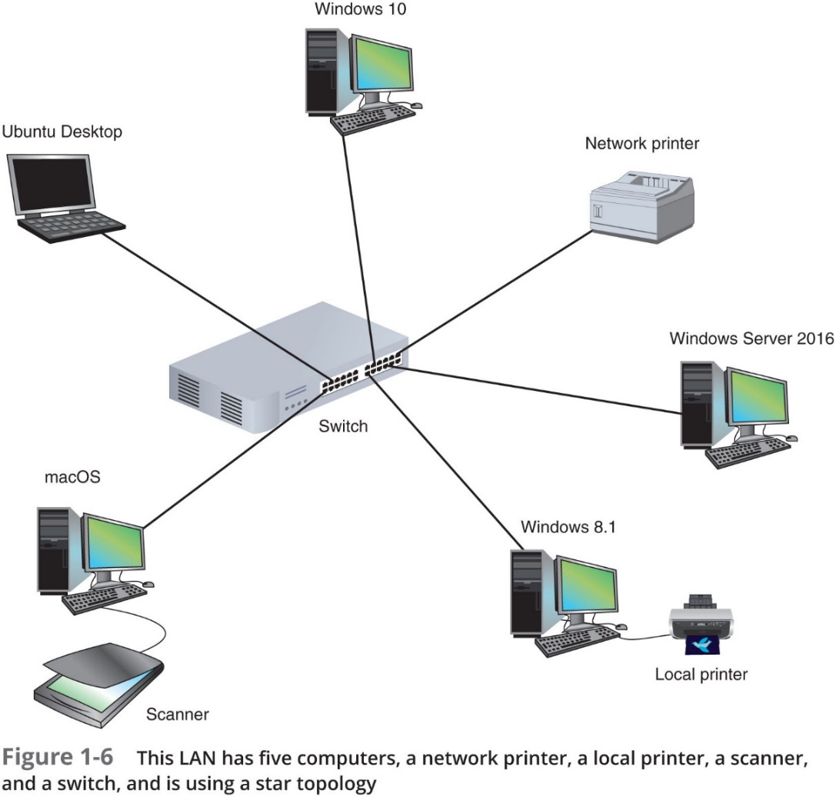
Network Hardware (2 of 9)

Slide 20
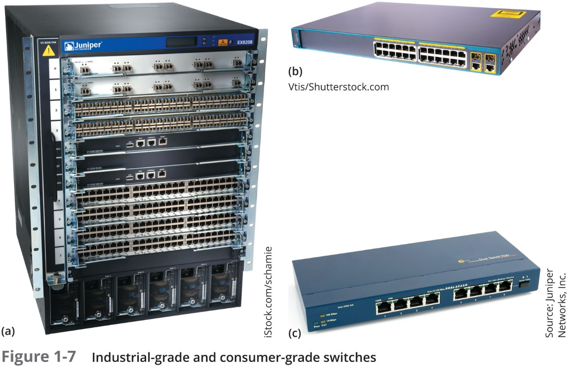
Network Hardware (3 of 9)

Slide 21
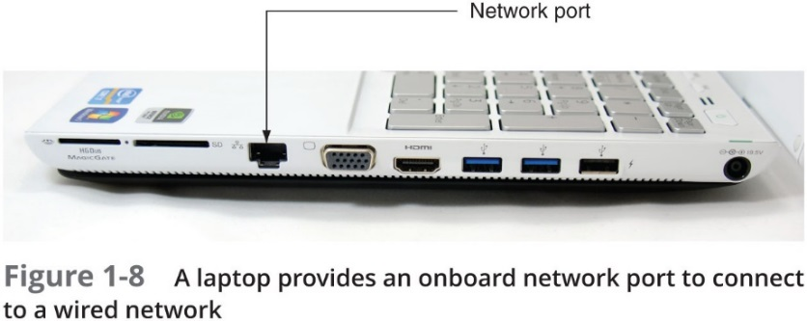
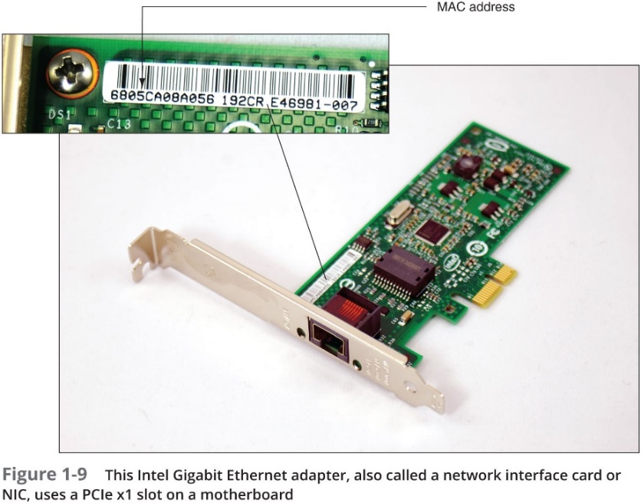
Network Hardware (4 of 9)

Slide 22
Network Hardware (5 of 9)
A LAN can have several switches
Backbone—A central conduit that connects the segments (pieces) of a network
Might use higher transmission speeds and different cabling than network cables connected to computers
Three switches daisy-chained together in a single line is said to use a bus topology
However, each switch is connected to computers via a star topology, making it a star-bus topology
A topology that combines topologies is known as a hybrid topology

Slide 23
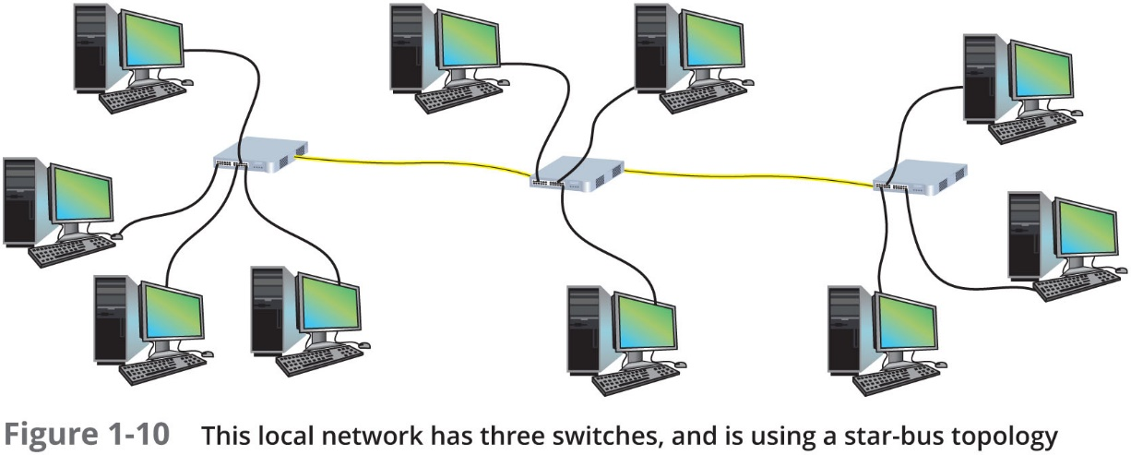
Network Hardware (6 of 9)

Slide 24
Network Hardware (7 of 9)
Router—A device that manages traffic between two or more networks
Can help find the best path for traffic to get from one network to another
Routers can be used in small home networks to connect the home LAN to the Internet
Called a S O H O (small office-home office) network
Industrial-grade routers can have several network ports, one for each network it connects to
Difference between router and switch:
Router is like a gateway between networks and belongs to two or more local networks
Switch belongs only to its local network

Slide 25
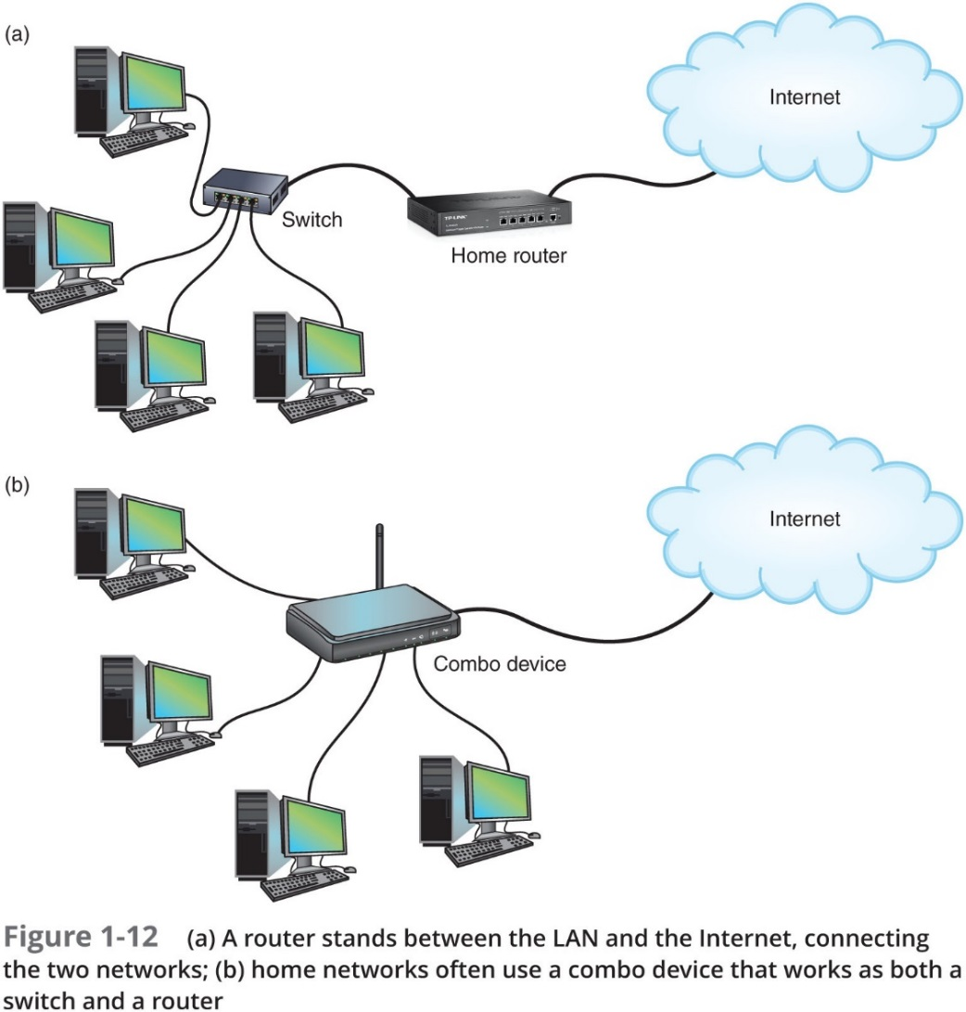
Network Hardware (8 of 9)

Slide 26
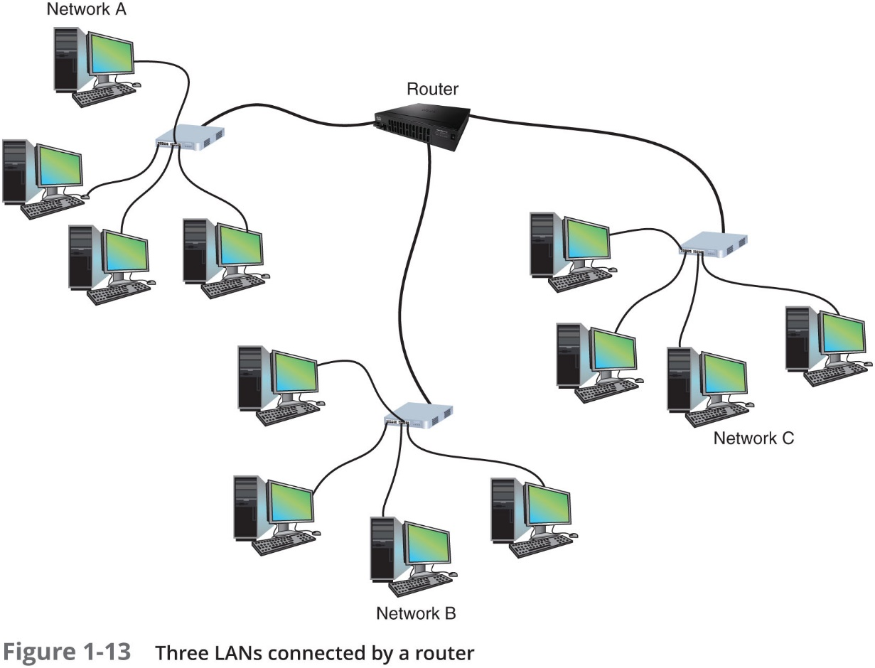
Network Hardware (9 of 9)

Slide 27
MANs and WANs (1 of 2)
Metropolitan area network (MAN)—A group of connected LANs in the same geographical area
Also known as a campus area network (CAN)
WAN (wide area network)—A group of LANs that spread over a wide geographical area
Internet is the largest and most varied WAN
MANs and WANs often use different transmission methods and media than LANs
PAN (personal area network)—Smallest network
A network of personal devices such as your smartphone and your computer

Slide 28
Types of Area Networks
WAN
MAN
CAN
SAN
LAN
WLAN
PAN

Slide 29
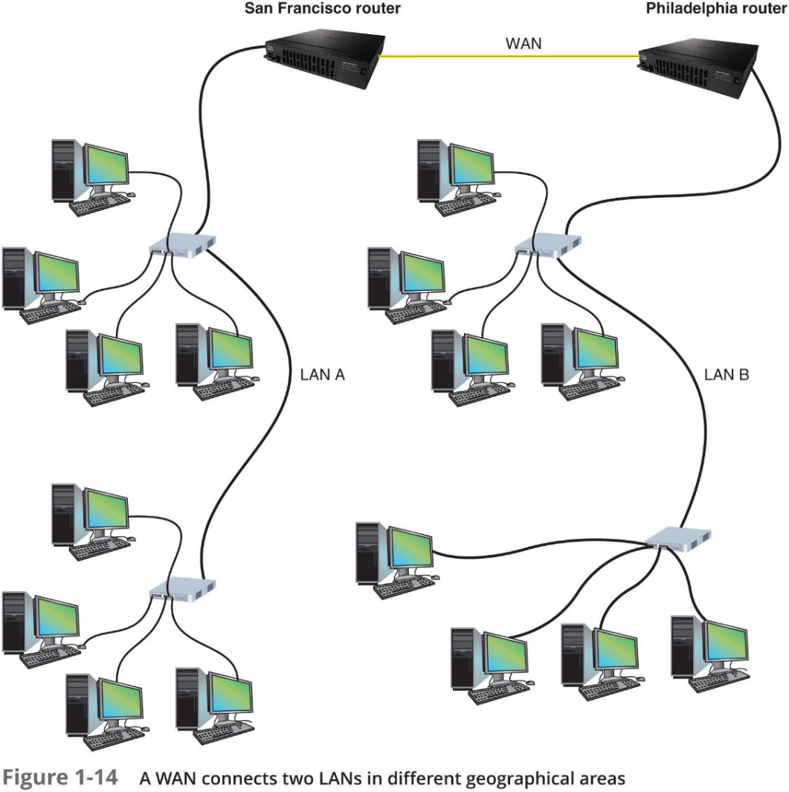
MANs and WANs (2 of 2)

Slide 30
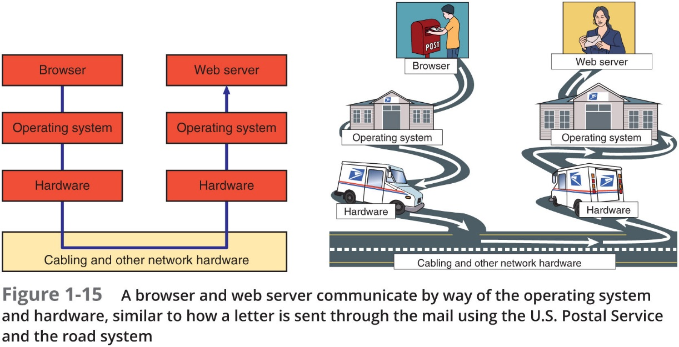
The Seven-Layer O S I Model (1 of 3)
Compare two devices communicating on a network to two people communicating by way of the U.S. Postal Service

Slide 31
The Seven-Layer O S I Model (2 of 3)
O S I (Open Systems Interconnection) reference model—A seven-layer model developed to categorize the layers of communication
The layers are numbered in order, starting with Layer 1, the Physical layer at the bottom
Physical, Data Link, Network, Transport, Session, Presentation, Application

Slide 32
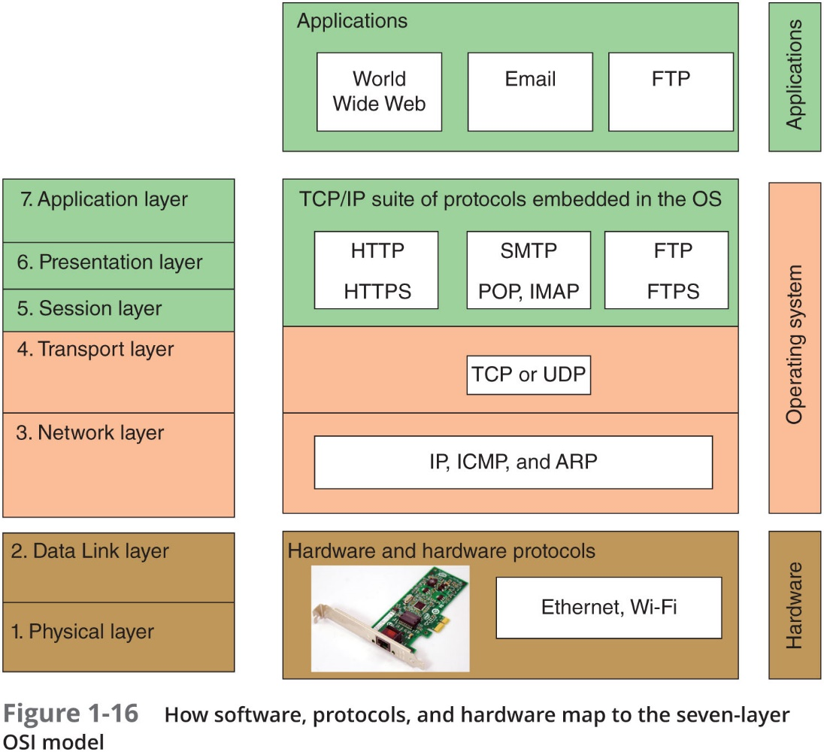
The Seven-Layer O S I Model (3 of 3)

Slide 33
Layer 7: Application Layer
Application layer—Describes the interface between two applications, on separate computers
Application layer protocols are used by programs that fall into two categories:
Provide services to a user, such as a browser and Web server
Utility programs that provide services to the system, such as S N M P that monitor and gather information about network traffic
Payload—Data that is passed between applications or utility programs and the O S

Slide 34
Layer 6: Presentation Layer
Presentation layer—Responsible for encoding, reformatting, compressing, and/or encrypting and decrypting data in a way that the receiving application can read
Examples:
An email message can be encrypted at the Presentation layer by the email client or by the O S
Zip program compressing a file for easier transport across a network
Reformatting analog voice data into digital format
Invoking SSL/TLS for web traffic

Slide 35
Layer 5: Session Layer
Session layer—Describes how data between applications is synched and recovered if messages don’t arrive intact at the receiving application
The Application, Presentation, and Session layers are intertwined
Often difficult to distinguish between them
Example: SSL/TLS operates at OSI Layers 7, 6, and 5
Most tasks are performed by the O S when an application makes an A P I call to the O S
Application programming interface (A P I) call is the method an application uses when it makes a request of the O S

Slide 36
Layer 4: Transport Layer (1 of 2)
Transport layer—Responsible for transporting Application layer payloads from one application to another
Two main Transport layer protocols are:
T C P (Transmission Control Protocol)—Makes a connection with the end host, checks whether data was received; called a connection-oriented protocol
U D P (User Datagram Protocol)—Does not guarantee delivery by first connecting and checking whether data is received; called a connectionless protocol

Slide 37
Layer 4: Transport Layer (2 of 2)
Protocols add their own control information in an area at the beginning of the payload (called a header)
Encapsulation—Process of adding a header to the data inherited from the layer above
The Transport layer header addresses the receiving application by a number called a port number
If message is too large, T C P divides it into smaller messages called segments
In U D P, the message is called a datagram

Slide 38
Layer 3: Network Layer
Network layer—Responsible for moving messages from one node to another until they reach the destination host
I P adds its own Network layer header to the segment or datagram
The entire Network layer message is called a packet
I P address—Assigned to each node on a network
Network layer uses it to uniquely identify each host
I P relies on several routing protocols to find the best route for a packet to take to reach destination
I C M P and A R P are examples
Network layer protocol will divide large packets into smaller packets
Process called fragmentation

Slide 39
Layer 2: Data Link Layer (1 of 2)
Layers 2 and 1 are responsible for interfacing with physical hardware on the local network
Protocols at these layers are programmed into firmware of a computer’s N I C and other hardware
Layer 2 is divided into two sublayers
MAC Sublayer: Responsible for physical addressing and Layer 2 protocols
Data Link Sublayer: Responsible for frame format prior to transmission
Type of networking hardware or technology used on a network determine the Link Layer protocol used
Ethernet and Wi-Fi are examples
The Link layer puts control information in a Link layer header and at the end of the packet in a trailer
Entire Link layer is called a frame

Slide 40
Layer 2: Data Link Layer (2 of 2)
MAC (Media Access Control) address—Hardware address of the source and destination N I Cs
Also called a physical address, hardware address, or Data Link layer address
Embedded on every network adapter and are considered short-range addresses that can only find nodes on the local network

Slide 41
Layer 1: Physical Layer
Physical layer—Simplest layer and is responsible for sending bits via a wired or wireless transmission
Can be transmitted as:
Wavelengths in the air
Voltage on a copper wire
Light (via fiber-optic cabling)

Slide 42
Protocol Data Unit or P D U
Protocol data unit (P D U)—The technical name for a group of bits as it moves from one layer to the next and from one LAN to the next
Technicians loosely call this group of bits a message or a transmission
Table 1-1 Names for a P D U or message as it moves from one layer to another
OSI model | Name | Extremely technical name
Layer 7, Application layer Layer 6, Presentation layer Layer 5, Session layer | Payload or data | L7P D U
Layer 4, Transport layer | Segment (T C P) or datagram (U D P) | L4P D U
Layer 3, Network layer | Packet | L3P D U
Layer 2, Data Link layer | Frame | L2P D U
Layer 1, Physical layer | Bit or transmission | L1P D U

Slide 43
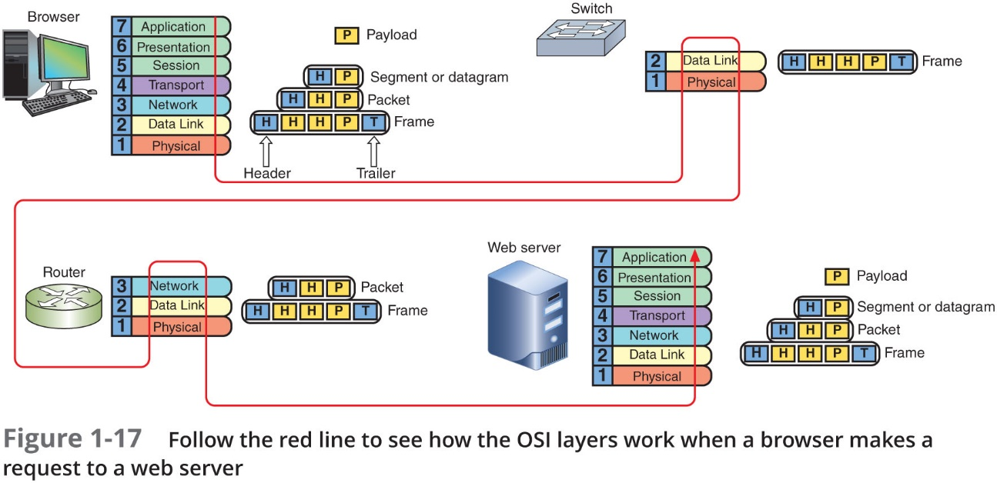
Summary of How the Layers Work Together

Slide 44
Safety Procedures and Policies
Network and computer technicians need to know how to protect themselves
As wells as protect sensitive electronic components
This section takes a look at some best practices for safety

Slide 45
Emergency Procedures (1 of 2)
Know the best escape route or emergency exit
Fire Suppression Systems—Have a fire suppression system in the data center that includes:
Emergency alert system
Portable fire extinguishers
Emergency power-off switch
Suppression agent
Fail Open or Fail Close—Does the security system allow access during a failure (fail open) or deny access during the failure (fail close)

Slide 46
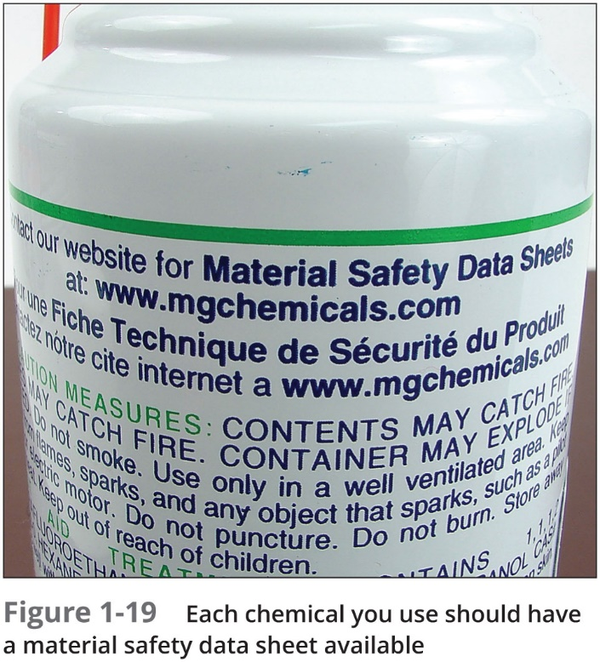
Emergency Procedures (2 of 2)
Material Safety Data Sheet (M S D S)—Explains how to properly handle substances such as chemical solvents and how to dispose of them
Includes information such as physical data, toxicity, health effects, first aid, storage, shipping, disposal, and spill procedures

Slide 47
Safety Precautions (1 of 5)
Electrical and tool safety is generally regulated by O S H A (Occupational Safety and Health Administration)
O S H A guidelines when using power tools:
Wear personal protective equipment (P P E)
Keep all tools in good condition and properly store tools not in use
Use the right tool for the job and operate the tool according to the manufacturer’s instructions
Watch out for trip hazards, so you and others don’t stumble on a tool or cord

Slide 48
Safety Precautions (2 of 5)
Lifting heavy objects—Follow these guidelines:
Decide which side of object to face so load is most balanced
Stand close to the object with your feet apart
Keep your back straight, bend knees and grip load
Lift with your legs, arms, and shoulders (not your back or stomach)
Keep the load close to your body and avoid twisting your body while you’re holding it
To put the object down, keep your back as straight as possible and lower object by bending your knees

Slide 49
Safety Precautions (3 of 5)
Protecting against static electricity:
Computer components are grounded inside a computer case
Grounding means that a device is connected directly to the earth
Sensitive electronic components can be damaged by electrostatic discharge (E S D)
Static electricity can cause two types of damage:
Catastrophic failure—destroyed beyond use
Upset failure—shorten the life of a component

Slide 50
Safety Precautions (4 of 5)
Before touching a component, ground yourself by:
Wearing an E S D strap around your wrist that clips onto the chassis or computer case
Touching the case before touching any component inside the case
Storing a component inside an antistatic bag
In addition to protecting against E S D, always shut down and unplug a computer before working inside it

Slide 51
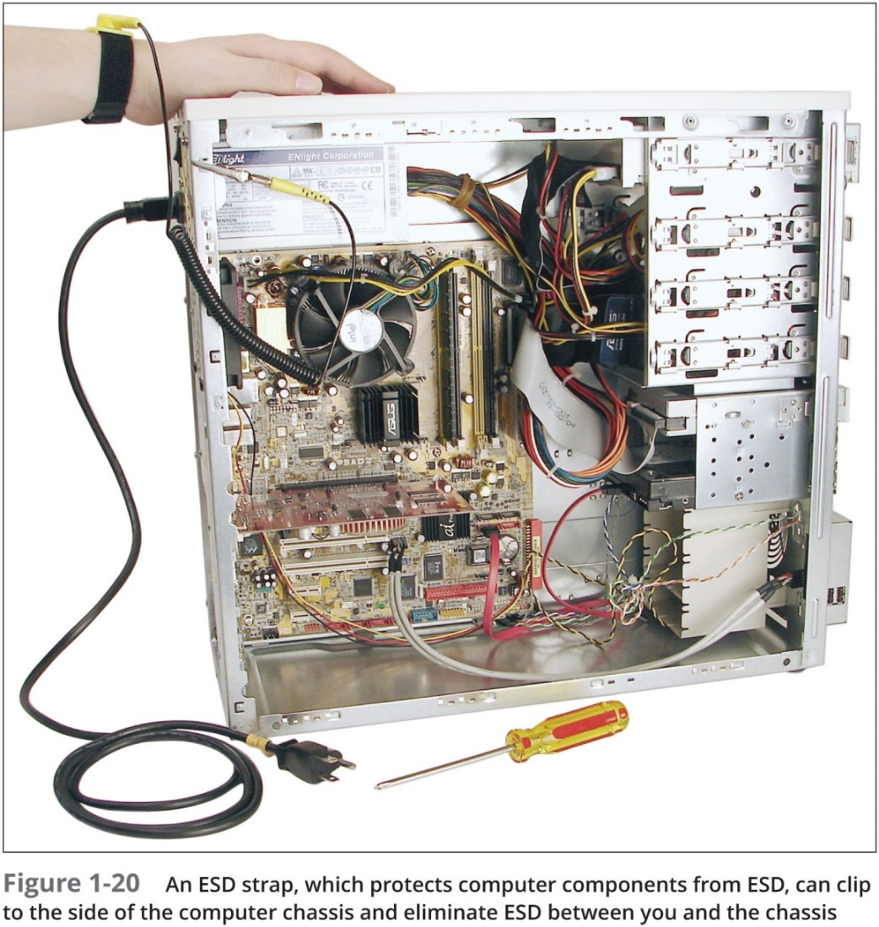
Safety Precautions (5 of 5)

Slide 52
Troubleshooting Network Problems (1 of 2)
Troubleshooting steps used by most expert networking troubleshooters:
Identify problem
Gather information
Identify symptoms
Question users
Determine if anything has changed
Establish theory of probable cause
Question the obvious
Test theory to determine cause
If theory confirmed, determine next steps
If theory not confirmed, establish new theory or escalate

Slide 53
Troubleshooting Network Problems (2 of 2)
Troubleshooting steps used by most expert networking troubleshooters (continued):
Establish action plan
Implement solution or escalate the problem
Verify full functionality
Implement preventative measures if applicable
Document findings, actions, outcomes

Slide 54
Chapter Summary (1 of 3)
The peer-to-peer model can be achieved using any assortment of desktop, mobile, or tablet O Ss
Peer-to-peer networks are simple to configure and less expensive than other types of networks
When Windows Server controls network access, the logical group is called a domain
Computers on a network are able to communicate with each other via the protocols they have in common
The fundamental difference between a switch and a router is that a switch belongs only to its local network and a router belongs to two or more local networks
A group of LANs spread over a wide geographical area is called a WAN (wide area network)

Slide 55
Chapter Summary (2 of 3)
The Application layer describes the interface between two applications, each on separate computers
The Presentation layer is responsible for reformatting, compressing, and/or encrypting data in a way that the application on receiving end can read
The Session layer describes how data between applications is synced and recovered if messages don’t arrive intact at the receiving application
The Transport layer transports Application layer payloads from one application to another
The Network layer moves messages from one node to another until they reach the destination host
Layers 2 and 1 are responsible for interfacing with the physical hardware only on the local network

Slide 56
Chapter Summary (3 of 3)
In case of an emergency, you’ll need to know the best escape route or emergency exit for you and others around you
Whenever possible, put heavy objects on a cart to move them
When your body and a component have different static charges and you touch the component, you can discharge up to 1500 volts of static electricity without seeing a spark or feeling the discharge
It only takes 10 volts to damage the component

